Slide 1



Noida Institute of Engineering and Technology, Greater Noida
Notion and Concepts
Unit: 1
Subject:
Compiler Design (ACSE504)
Rohit Chaudhary
Assistant Professor
CSE Department
Course Details B Tech CSE 5th Sem

Slide 2
Brief Introduction of Faculty
Rohit chaudhary
Designation: Assistant Professor CSE Department
NIET Grater Noida
Teaching experience: 7 years
Research Publications: 04

Slide 3
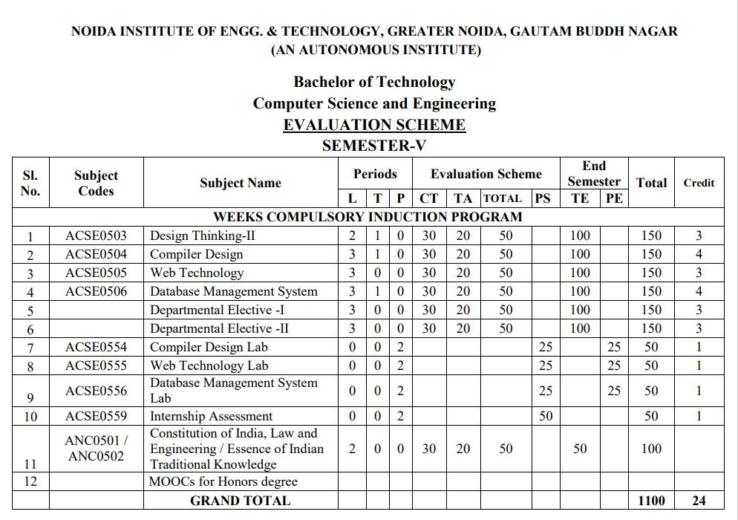
Evaluation Scheme

Slide 4
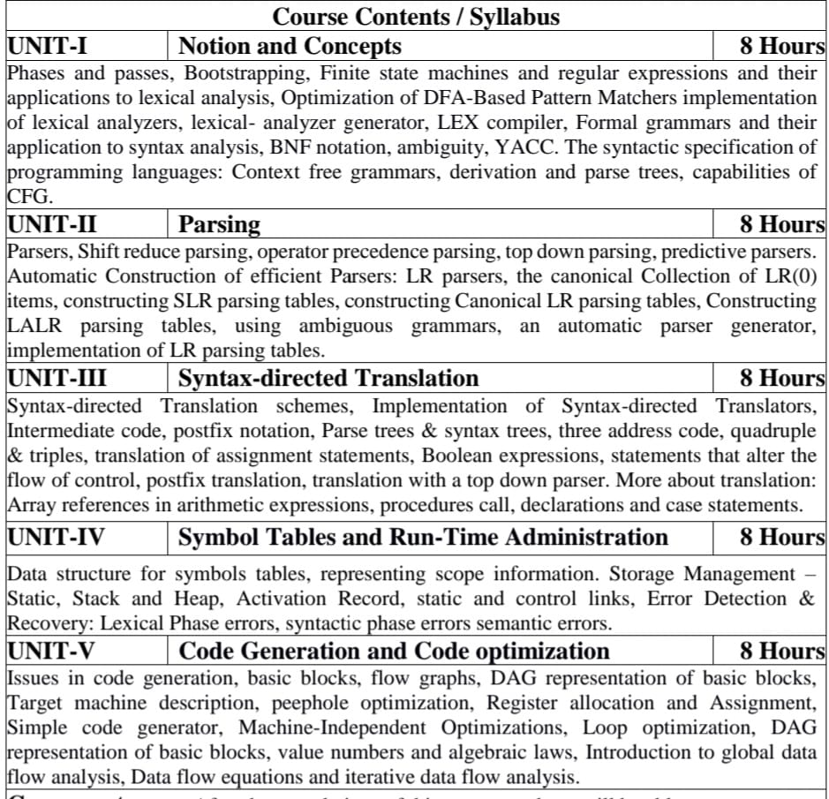
Syllabus

Slide 5
Branch wise Applications
Computer Science/ IT
Compiler technology can be used to translate the binary code for one machine to that of another, allowing a machine to run programs originally compiled for another instruction set. Binary translation technology has been used by various computer companies to increase the availability of software for their machines
Implementations of High Level Programming
Optimization of Computer Architecture
Design of New Computer Architecture
Program Translation
Software Productive tools

Slide 6
Course Objectives
Introduce students to the concepts underlying the design and implementation of language processors. More specifically, by the end of the course, students will be able to answer these questions:
What language processors are, and what functionality do they provide to their users?
What core mechanisms are used for providing such functionality?
How are these mechanisms implemented?
Apart from providing a theoretical background, the course places a special emphasis in practical issues in designing language processors.

Slide 7
Course Outcome
CO1: To have the knowledge of patterns, tokens, regular expressions and finite automata to develop a scanner or lexical analyzer.
CO2: To design and develop various parser by parsing LL parser and LR parser
CO3: To apply various design & conduct experiments for Intermediate Code Generation in compiler.
CO4: To design and develop various Data structure for symbols tables and Error Detection & Recovery at every phases
CO5: To apply various new code optimization techniques to improve the performance of a program in terms of speed & space.

Slide 8
Program Outcomes (PO)
PO1: Engineering Knowledge
PO2: Problem Analysis
PO3: Design/Development of solutions
PO4: Conduct Investigations of complex problems
PO5: Modern tool usage
PO6: The engineer and society
PO7: Environment and sustainability
PO8: Ethics
PO9: Individual and team work
PO10: Communication
PO11: Project management and finance
PO12: Life-long learning

Slide 9
CO-PO Mapping
 | PO1 | PO2 | PO3 | PO4 | PO5 | PO6 | PO7 | PO8 | PO9 | PO10 | PO11 | PO12
ACSE504.1 | 3 | 3 | 3 | 3 | 3 | 1 | 1 | 1 | 3 | 1 | 2 | 2
ACSE504.2 | 3 | 3 | 3 | 3 | 3 | 1 | 1 | 1 | 3 | 1 | 2 | 2
ACSE504.3 | 3 | 3 | 3 | 3 | 3 | 1 | 1 | 1 | 3 | 1 | 2 | 2
ACSE504.4 | 3 | 2 | 3 | 3 | 3 | 1 | 1 | 1 | 3 | 1 | 2 | 2
ACSE504.5 | 3 | 2 | 3 | 3 | 3 | 1 | 1 | 1 | 3 | 1 | 2 | 2
AVG | 3 | 2.6 | 3 | 3 | 3 | 1 | 1 | 1 | 3 | 1 | 2 | 2

Slide 10
Program Specific Outcomes (PSO)
PSO1: Work as a software developer, database administrator, tester or networking engineer for providing solutions to the real world and industrial problems
PSO2:Apply core subjects of information technology related to data structure and algorithm, software engineering, web technology, operating system, database and networking to solve complex IT problems.
PSO 3:Practice multi-disciplinary and modern computing techniques by lifelong learning to establish innovative career.
PSO 4:Work in a team or individual to manage projects with ethical concern to be a successful employee or employer in IT industry

Slide 11
CO-PSO Mapping
 | PSO1 | PSO2 | PSO3 | PSO4
ACSE0504.1 | 3 | 3 | 3 | 1
ACSE0504.2 | 3 | 3 | 3 | 1
ACSE0504.3 | 3 | 3 | 3 | 1
ACSE0504.4 | 3 | 3 | 3 | 1
ACSE0504.5 | 3 | 3 | 3 | 1
AVG | 3 | 3 | 3 | 1

Slide 12
Program Educational Objectives
PEO1: To have an excellent scientific and engineering breadth so as to
comprehend, analyze, design and provide sustainable solutions for
real-life problems using state-of-the-art technologies.
PEO2:To have a successful career in industries, to pursue higher studies or
to support entrepreneurial endeavors and to face global challenges.
PEO3:To have an effective communication skills, professional attitude,
ethical values and a desire to learn specific knowledge in emerging
trends, technologies for research, innovation and product
development and contribution to society.
PEO4: To have life-long learning for up-skilling and re-skilling for
successful professional career as engineer, scientist, enterpreneur
and bureaucrat for betterment of society

Slide 13
Result Analysis
Subject Result: 100 %
Department Result: 99 %
Faculty-Wise Result:
Ms Divya Chaudhary (A): 100%
Mr. Rohit Chaudhary (B): 100%
Mr. Vivek Sharma (C): 97.06%
Ms. Divya Chaudhary(D): 100%

Slide 14
End Semester Question Paper Template
B TECH
(SEM-V) THEORY EXAMINATION 20__-20__
COMPILER DESIGN
Time: 3 Hours Total Marks: 100
Note: 1. Attempt all Sections. If require any missing data; then choose suitably.
SECTION A
Attempt all questions in brief. 2 x 10 = 20
Q.No. | Question | Marks | CO
1 |  | 2
2 |  | 2
. |  | .
10 |  | 2

Slide 15
End Semester Question Paper Templates
SECTION B
2. Attempt any three of the following: 3 x 10 = 30
SECTION C
3. Attempt any one part of the following: 1 x 10 = 10
Q.No. | Question | Marks | CO
1 |  | 10
2 |  | 10
. |  | .
5 |  | 10
Q.No. | Question | Marks | CO
1 |  | 10
2 |  | 10

Slide 16
End Semester Question Paper Templates
4. Attempt any one part of the following: 1 x 10 = 10
5. Attempt any one part of the following: 1 x 10 = 10
6. Attempt any one part of the following: 1 x 10 = 10
Q.No. | Question | Marks | CO
1 |  | 10
2 |  | 10
Q.No. | Question | Marks | CO
1 |  | 10
2 |  | 10
Q.No. | Question | Marks | CO
1 |  | 10
2 |  | 10

Slide 17
End Semester Question Paper Templates
7. Attempt any one part of the following: 1 x 10 = 10
Q.No. | Question | Marks | CO
1 |  | 10
2 |  | 10

Slide 18
Prerequisite
Theory of Automata
Algorithms
Languages and machines
Operating systems
Computer architectures

Slide 19
Recap
Language processing system
Finite Automata
Production rules
Chomsky hierarchy of grammar

Slide 20
Unit Content
Introduction
Translator
Compiler
Simple structure of compiler
Phases of Compiler
The structure of compiler
Analogy
An example
Language Processing System
Pass of Compiler
Front end and back end of compiler
Bootstrapping and Cross Compiler
Finite Automata
Regular Expression
Thompson’s Method
Subset Construction Method
Lexical Analysis
Context Free Grammar

Slide 21
Unit Objective(CO1)
Introduce students to the concepts of simple structure of Compiler .
Introduce students to the concepts of Token through finite automata
Introduce students to the concepts of scanner.

Slide 22
Topic Objective(CO1)
Introduce students to the concepts of simple structure of Compiler .

Slide 23
Introduction(CO1)
Target program is a running process on any computer which accepts some input and in response generates desired output.
Input
Target Program
Output

Slide 24
Introduction(CO1)
Compiler:
A program that translates a source program written in high level language into target/executable program written in low level language is called compiler.
High Level Language:
Which closer to human understanding. Ex- C, C++, Java, Pascal etc
Low Level Language:
Which is closer to computer understanding. Ex- Machine Language and assembly language.
High level language
Compiler
Low level language

Slide 25
Introduction(CO1)
We generally write a computer program using a high-level language. A high-level language is one that is understandable by us, humans. This is called source code.
However, a computer does not understand high-level language. It only understands the program written in 0's and 1's in binary, called the machine code.
To convert source code into machine code, we use either a compiler or an interpreter.
Both compilers and interpreters are used to convert a program written in a high-level language into machine code understood by computers. However, there are differences between how an interpreter and a compiler works

Slide 26
Difference (CO1)
Interpreter | Compiler
Translates program one statement at a time. | Scans the entire program and translates it as a whole into machine code.
Interpreters usually take less amount of time to analyze the source code. However, the overall execution time is comparatively slower than compilers. | Compilers usually take a large amount of time to analyze the source code. However, the overall execution time is comparatively faster than interpreters.
No Object Code is generated, hence are memory efficient. | Generates Object Code which further requires linking, hence requires more memory.
Programming languages like JavaScript, Python, Ruby use interpreters. | Programming languages like C, C++, Java use compilers.

Slide 27
Simple Structure of a Compiler(CO1)
Process of compilation involves two major phases.
Analysis Phase:
Where Source program is analyzed for errors.
Synthesis Phase:
Where source is converted into target program.
Source program
Source program
Analysis
Compiler
Synthesis
Target program
Target program

Slide 28
Phases of Compiler: Structure of a Compiler(CO1)
Source Program
Lexical Analysis
Syntax Analysis
Symbol Table management
Semantic Analysis
Error Handler
Intermediate Code Generation
Code Optimization
Target Code Generation
Target Program

Slide 29
Phases of Compiler : Analogy of Natural language(CO1)
Si a htis omipcerl aslsc. → Tokens(words) are not correct Lexical Error
Is a class this compiler. → Valid tokens but sentence is not correct syntax error
This is a compiler class. → correct syntax but semantic error
This is a compiler design class. → correct statement
Converting each word individually into its meaning is:
Intermediate code generation.
Code optimization is optional phase.
Complete translation of the sentence by using individual meaning of each word is:
Target code generation

Slide 30
Phases of Compiler: An Example(CO1)
Statement: P = I + R * 40
Intermediate Code Generation
Lexical Analysis
t1 = inttofloat (40)
t2 = id3 * t1
t3 = id2+t2
id1 = t3
Id1 = id2 + id3 * 40
Syntax Analysis
=
Code Optimization
id1
+
t1 = id3 * 40.0
id1 = id2 + t1
id2
*
id3
40
Target Code Generation
Semantic Analysis
=
LDF R2, id3
MULF R2, #40.0
LDF R1, id2
ADDF R1, R2
STF id1, R1
id1
+
id2
*
id3
int to float
40

Slide 31
Recap
Compiler is a translator that converts the high level language to low level language
Simple Structure of Compiler
Phases of complier

Slide 32
Daily Questions
Define Compiler and Interpreter.
Differentiate between compiler and Interpreter.
Explain the phases of compiler.
Define Lexical Analysis phase.
Explain types of passes of compiler

Slide 33
Topic Objective(CO1)
Introduce students to the concepts of language processing system how a program is going to interact with different program in a system

Slide 34
Language Processing System(CO1)
Source Program
Pre-Processor
Pre-Processed Code {#include, #define etc
Compiler
Target Assembly Code
Assembler
Re-locatable machine Code
Linker
Executable Machine Code {Library files, More obj. files
Loader
Memory
Processor

Slide 35
Topic Objective(CO1)
Introduce students to the concepts of the different pass and categories of compiler

Slide 36
Pass of Compiler(CO1)
Pass: A Compiler Pass refers to the traversal of a compiler through the entire program.
Pass also refers to the grouping of phases in different module.
Compiler pass are of two types:
Single Pass Compiler
Two Pass Compiler or Multi Pass Compiler
Single Pass: If we combine or group all the phases of compiler design in a single module known as single pass compiler.
Multi Pass: A Two pass/multi-pass Compiler is a type of compiler that processes the source code or abstract syntax tree of a program multiple times. In multi pass Compiler we divide phases in two or more Module.

Slide 37
Single Pass Compiler
Lexical Analysis
Syntax Analysis
Single Pass: All the units are in one module
Semantic Analysis
Intermediate Code Generation
Code Optimization
Target Code Generation

Slide 38
Two Pass or Multi-Pass Compiler
Lexical Analysis
Syntax Analysis
First Pass: Front End
Semantic Analysis
Intermediate Code Generation
Code Optimization
Second Pass: Back End
Target Code Generation

Slide 39
Front-End & Back- End of Compiler(CO1)
Lexical Analysis
Syntax Analysis
Front End ,Related to Source Language (Machine Independent)
Semantic Analysis
Intermediate Code Generation
Code Optimization
Back End, Related to Target Language ( Machine Dependent)
Target Code Generation

Slide 40
Recap
Passes of Compiler
One Pass
Two Pass
Three Pass
Front and Back end Compiler

Slide 41
Topic Objective(CO1)
Introduce students to the concepts of handling the complicated language to understand the more complicated language

Slide 42
Bootstrapping(CO1)
Bootstrapping is a process in which simple language is used to translate more complicated program which in turn may handle for more complicated program.
This complicated program can further handle even more complicated program and so on.
Using facilities provided by compiler to compile itself is essential feature of bootstrapping concept

Slide 43
Bootstrapping…
Language Associated with a Compiler:
Source Language(S): Language for which compiler is designed.
Target Language(T): Language in which compiler generates final code
Implementation Language(I): Language in which compiler itself is written.

Slide 44
Bootstrapping…
T Diagram Representation of Compiler:
Source Language: S
Target Language: T
Implementation Language: I
S
T
I

Slide 45
Cross Compiler(CO1)
A Compiler which runs on one machine and generates target code for Another machine is called Cross Compiler.
Above compiler compiles program written in language S on machine M but
will generate target code for machine N.
S
N
M
Cross Compiler

Slide 46
Bootstrapping and Cross Compiler(CO1)
Question:
Create a compiler for language S on machine N by using an existing compiler for same language on machine M.
Solution:
Given:
Desired:
S
M
M
S
N
N

Slide 47
Bootstrapping and Cross Compiler
Solution:
Step1: Write a program to design a compiler using language S on machine M which generates target as N.
Step2: Run Designed compiler on existing one.
Step3: Run Designed compiler on new cross compiler.
S
N
S
S
N
S
N
S
S
M
M
A Cross Compiler is created
M
S
N
S
N
S
S
N
N
Desired Compiler is created
M

Slide 48
Bootstrapping and Cross Compiler
Question:
Create a compiler for language P on machine N by using an existing compiler for language S on machine M.
Solution:
Given:
Desired:
S
M
M
P
N
N

Slide 49
Bootstrapping and Cross Compiler
Solution:
Step1: Write a program to design a compiler using language S on machine M for source language P which generates target as N.
Step2: Run Designed compiler on existing one.
Step3: Write a program to design a compiler using language P on machine M for source language P which generates target as N
P
N
S
P
N
P
N
S
S
M
M
A Cross Compiler is created
M
P
N
P

Slide 50
Bootstrapping and Cross Compiler
Solution:
Step4: Run Designed compiler in step3 on new cross compiler.
P
N
P
N
P
P
N
N
Desired Compiler is created
M

Slide 51
Recap
Bootstrapping is a process in which simple language is used to translate more complicated program
A Compiler which runs on one machine and generates target code for Another machine is called Cross Compiler

Slide 52
Topic Objective(CO1)
Introduce students to the concepts of tokens how the automata is useful in finding tokens

Slide 53
Finite Automata(CO1)
A finite automaton is a machine used to recognize patterns within input taken from some character set (or alphabet) .
The job of an FA is to accept or reject an input depending on whether the pattern defined by the FA occurs in the input.
Finite Automata (M) is defined by 5-tuples.
M = (Q, ∑, q0 , δ ,F)
Q: Finite set of non empty states.
∑: Finite set of input characters or alphabets.
q0: Initial state.
δ: State transition function.
F: Non empty set of final states.

Slide 54
Types of Finite Automata
There are two types of finite automata.
Deterministic Finite Automata (DFA)
One transition per input per state
No ε-moves (null moves)
Nondeterministic Finite Automata (NFA)
Can have multiple transitions for one input in a given state
Can have ε-moves

Slide 55
Deterministic Finite Automata (DFA)
State transition function of DFA is:
δ: Q X ∑ → Q
Example: Let Q = {q0, q1}, ∑= {a, b} then
Q X ∑ = { (q0,a), (q0, b), (q1, a), (q1, b) }
δ: Q X ∑ → Q
Q X ∑
Q
(q0,a)
(q0, b)
(q1, a)
(q1, b)
q0
q1
One transition per input
per state and no ε-moves

Slide 56
Nondeterministic Finite Automata (NFA)
State transition function of NFA is:
δ: Q X ∑ → P(Q)
Example: Let Q = {q0, q1}, ∑= {a, b} then
Q X ∑ = { (q0,a), (q0, b), (q1, a), (q1, b) }
P(Q) (Power set of Q) = { {}, {q0}, {q1}, {q0, q1} }
δ: Q X ∑ → P(Q)
Q X ∑
P(Q)
(q0,a)
(q0, b)
(q1, a)
(q1, b)
{}
{q0} {q1} {q0, q1}
Multiple transitions for
one input in a given state

Slide 57
Representation of Finite Automata
State Transition Diagram
States are represented by:
Inputs are represented by:
Initial state:
Final States:
DFA of string ending with 0 over input set {0, 1}:
q
q
q
1
0
q0
0
q1
1

Slide 58
Representation of Finite Automata
State Transition Table: A 2-D Array is used
Rows are represented by states (Q)
Columns are represented by input characters (∑)
DFA of string ending with 0 over input set {0, 1}:
Q
∑
0
1
1
0
q0
0
q1
q0
q1
q0
1
q1
q1
q0

Slide 59
Regular Expression
A regular expression is a mathematical representation of a pattern which is used to formulate tokens of any high level programming language.
Regular Expressions can be:
ε is a regular Expression (null move)
Every ‘a’ belonging to ∑ is a regular expression
Let R is a regular expression then
R* (Kleen’s Closure): Zero or more occurrence of R is a regular expression.
R⁺ : one or more occurrence of R is a regular expression.
R?: at most one occurrence of R is a regular expression.
Let R and S are regular expressions then
R/S or R+S: R or S is a regular expression.
R.S: concatenation is a regular expression.

Slide 60
Regular Expression to NFA Conversion(CO1)
Thompson’s Method:
ε is a regular Expression (null move)
Every ‘a’ belonging to ∑ is a regular expression
R.S is a regular expression
R+S is a regular expression
R* is a regular expression
ε
a
ε
R
S
ε
ε
R
ε
S
ε
ε
ε
ε
R
ε

Slide 61
Precedence of Operators in Regular Expression
S.No. | Operator Symbol | Operator Name | Precedence Priority
1 | () | Parenthesis | 1
2 | *, +, ? | Unary Operator | 2
3 | . | Concatenation | 3
4 | / | OR | 4

Slide 62
Example of Regular Expression to NFA
Consider the regular expression (1 + 0)*.1 and construct equivalent NFA.
By precedence:
(1+0)
(1+0)*
1
(1+0)*.1
ε
1
ε
ε
ε
ε
1
ε
0
ε
ε
ε

Slide 63
NFA With Null Moves to DFA Conversion
Some definition used in the method
ε-Closure (S): Set of states reachable from state S via epsilon.
ε-Closure (T): Set of states reachable from any state in set T via epsilon.
move (T, a): Set of states to which there is an NFA transition from states in T on a symbol a.
D_states: Set of states in equivalent DFA.
D_Tran: Transition table of equivalent DFA.

Slide 64
NFA With Null Moves to DFA Conversion
Subset Construction Method: (ε-Closure Method)
Input: NFA with ε moves.
Output: Equivalent DFA
Algorithm:
Begin
Initially, add ε-Closure (S₀) in D_Trans { Where S₀ is initial state of NFA}
for every unmarked state T in D_states
mark T
for each input symbol 'a‘ belonging to ∑
do U = ε-Closure (T, a)
If U is not in D_states
then add U to D_states
add D_Trans [T, a] = U
End

Slide 65
Example of NFA with ε moves to DFA Conversion
ε
1
2
2
2
2
3
3
3
3
3
ε
ε
ε
ε
1
ε
6
6
6
7
7
7
7
8
8
8
8
9
9
9
9
9
0
0
1
1
1
1
0
ε
ε
4
4
4
4
5
5
5
5
5
ε
D_Tran
D_States
∑
0
1
Move(A,0)
= { 5 }
Move(A,1)
= { 3,9 }
ε-Closure(0)
= {0,1,2,4,7,8}
= A
B
C
Move(B,0)
= { 5 }
ε-Closure(5)
= {1,2,4,5,6,7,8}
= B
B
C
Move(B,1)
= { 3 ,9}
Move(C,0)
= { 5 }
ε-Closure(3,9)
= {1,2,3,4,6,7,8,9}
= C
B
C
Move(C,1)
= { 3 ,9}

Slide 66
Regular Expressions to Finite Automata
NFA
DFA
Regular
expressions
Table-driven
Implementation of DFA
Lexical
Specification

Slide 67
Application Finite Automata in lexical Analysis
A scanner or lexical analyzer for the language uses a DFA (recognizer of regular languages) in its core. Different final states of the DFA identifies different tokens.
In the lexical analysis, finite automata are used to produce tokens or streams in the form of identifiers, keywords, and constants from the input program

Slide 68
Recap
There are two types of finite automata.
Deterministic Finite Automata (DFA)
One transition per input per state
No ε-moves (null moves)
Nondeterministic Finite Automata (NFA)
Can have multiple transitions for one input in a given state
Can have ε-moves
A regular expression is a mathematical representation of a pattern
Thompson’s method
Subset Construction Method: (ε-Closure Method)

Slide 69
Topic Objective(CO1)
Introduce students to the concepts of scanner how a lexical analyser work in compiler designing

Slide 70
Lexical Analysis
Lexical Analysis is the first phase of the compiler also known as a scanner. It converts the High level input program into a sequence of Tokens.
Lexical Analysis can be implemented with the Deterministic finnite Automata
The output is a sequence of tokens that is sent to the parser for syntax analysis

Slide 71
How Lexical Analyzer works-
Input preprocessing: This stage involves cleaning up the input text and preparing it for lexical analysis. This may include removing comments, whitespace, and other non-essential characters from the input text.
Tokenization: This is the process of breaking the input text into a sequence of tokens. This is usually done by matching the characters in the input text against a set of patterns or regular expressions that define the different types of tokens.
Token classification: In this stage, the lexer determines the type of each token. For example, in a programming language, the lexer might classify keywords, identifiers, operators, and punctuation symbols as separate token types.
Token validation: In this stage, the lexer checks that each token is valid according to the rules of the programming language. For example, it might check that a variable name is a valid identifier, or that an operator has the correct syntax.
Output generation: In this final stage, the lexer generates the output of the lexical analysis process, which is typically a list of tokens. This list of tokens can then be passed to the next stage of compilation or interpretation

Slide 72
Lexical Analysis(CO1)
Interface diagram of Lexical Analysis
token
Source
program
Lexical Analyzer
Syntax Analysis
To semantic
analysis
getNextToken
Symbol
table

Slide 73
Tokens, Patterns and Lexemes(CO1)
Token
It is basically a sequence of characters that are treated as a unit as it cannot be further broken down.
In programming languages like C language- keywords (int, char, float, const, goto, continue, etc.) identifiers (user-defined names), operators (+, -, *, /), delimiters/punctuators like comma (,), semicolon(;), braces ({ }), etc. , strings can be considered as tokens.
Int a = 10; //Input Source code
Tokens
int (keyword), a(identifier), =(operator), 10(constant) and ;(punctuation-semicolon)
Total number of tokens-5

Slide 74
Tokens, Patterns and Lexemes(CO1)
Lexeme
It is a sequence of characters in the source code that are matched by given predefined language rules for every lexeme to be specified as a valid token.
Example
Main is lexeme of type identifier(token).
(,),{,} are lexemes of type punctuation(token)
Pattern
It specifies a set of rules that a scanner follows to create a token.
Example
For a keyword to be identified as a valid token, the pattern is the sequence of characters that make the keyword.
For identifier to be identified as a valid token, the pattern is the predefined rules that it must start with alphabet, followed by alphabet or a digit

Slide 75
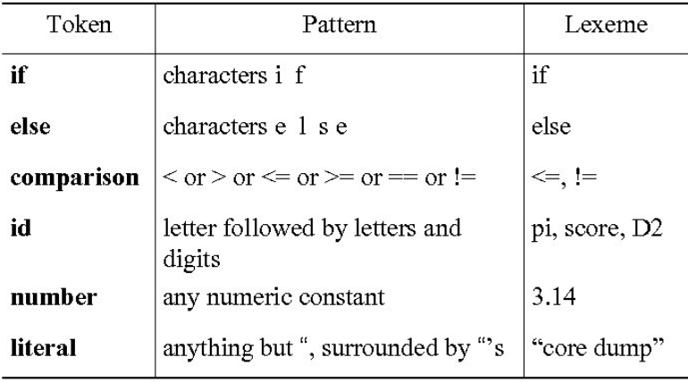
Example of Tokens, Patterns and Lexemes

Slide 76
Designing of Lexical Analyzer(CO1)
List out all the alphabets, characters and tokens with their pattern allowed in the language:
digit -> [0-9]
Digits -> digit+
number -> digit(.digits)? (E[+-]? Digit)?
letter -> [A-Za-z_]
id -> letter (letter|digit)*
If -> if
Then -> then
Else -> else
Relop -> < | > | <= | >= | = | <>
White_space -> (blank | tab | newline)+

Slide 77
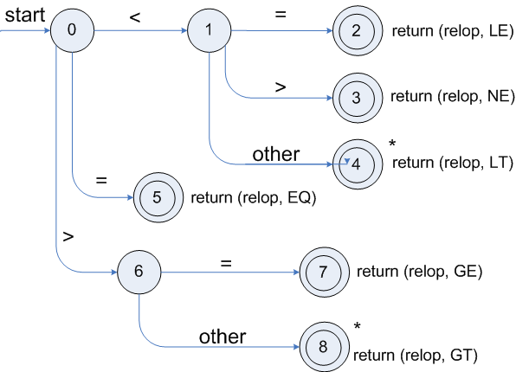
Designing of Lexical Analyzer
Construction of state diagram for every token according to pattern:
Transition diagrams of relop

Slide 78
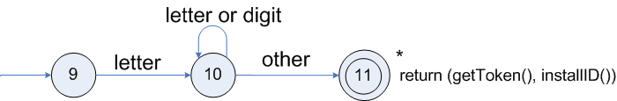
Designing of Lexical Analyzer
Transition diagram for identifiers

Slide 79
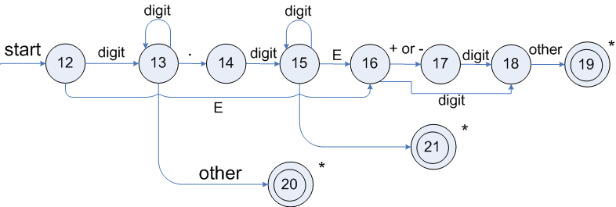
Designing of Lexical Analyzer
Transition diagram for unsigned numbers

Slide 80
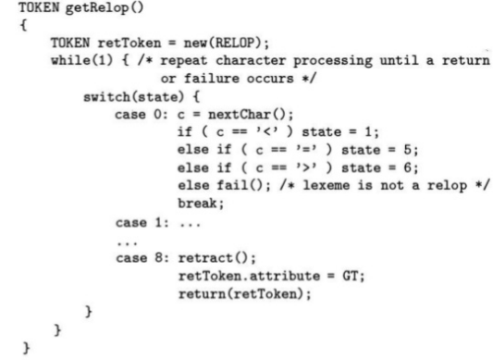
Designing of Lexical Analyzer
Implementation of relop transition Diagram:

Slide 81
Recap
Tokens, Patterns and Lexemes with example
Designing of Lexical Analyzer
Lexical analysis turns input characters into tokens.
Lexical syntax is described by regular expressions.

Slide 82
LEX
Lex is a program that generates lexical It reads the input stream and produces the source code as output through implementing the lexical analyzer in the C program.
It is used with YACC parser generator.
The lexical analyzer is a program that transforms an input stream into a sequence of tokens.

Slide 83
LEX
Firstly lexical analyzer creates a program lex.1 in the Lex language. Then Lex compiler runs the lex.1 program and produces a C program lex.yy.c.
Finally C compiler runs the lex.yy.c program and produces an object program a.out.
a.out is lexical analyzer that transforms an input stream into a sequence of tokens

Slide 84
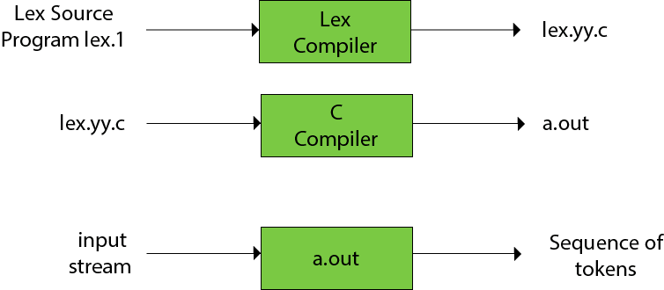
LEX

Slide 85
LEX
A Lex program is separated into three sections by %% delimiters. The formal of Lex source is as follows:
{ definitions }
%%
{ rules }
%%
{ user subroutines }

Slide 86
Topic Objective(CO1)
Introduce students to the concepts of language used to design the compiler.

Slide 87
Backus-Naur Form
BNF stands for Backus-Naur Form. It is used to write a formal representation of a context-free grammar. It is also used to describe the syntax of a programming language.
BNF notation is basically just a variant of a context-free grammar.
In BNF, productions have the form:
Left side → definition
In BNF, we can represent above grammar as follows:
S → aSa| bSb| c

Slide 88
YACC
YACC stands for Yet Another Compiler Compiler.
YACC provides a tool to produce a parser for a given grammar.
YACC is a program designed to compile a LALR (1) grammar.
It is used to produce the source code of the syntactic analyzer of the language produced by LALR (1) grammar.
The input of YACC is the rule or grammar and the output is a C program.

Slide 89
Topic Objective(CO1)
Context free grammar G can be defined by four tuples as:
G= (V, T, P, S)
T describes a finite set of terminal symbols.
V describes a finite set of non-terminal symbols
P describes a set of production rules
S is the start symbol.

Slide 90
Context free grammars(CO1)
Terminals
Non terminals
Start symbol
productions
expression -> expression + term
expression -> expression – term
expression -> term
term -> term * factor
term -> term / factor
term -> factor
factor -> (expression)
factor -> id

Slide 91
Derivation(CO1)
Productions are treated as rewriting rules to generate a string
Rightmost and leftmost derivations
E -> E + E | E * E | -E | (E) | id
Derivations for –(id+id)
E => -E => -(E) => -(E+E) => -(id+E)=>-(id+id)

Slide 92
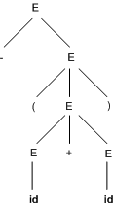
Parse trees(CO1)
-(id+id)
E => -E => -(E) => -(E+E) => -(id+E)=>-(id+id)

Slide 93
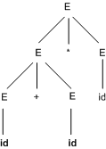
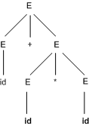
Ambiguity(CO1)
For some strings there exist more than one parse tree
Or more than one leftmost derivation
Or more than one rightmost derivation
Example: id+id*id

Slide 94
Recap
Context Free grammar
Parse Tree
Ambiguity

Slide 95
capabilities of CFG
There are the various capabilities of CFG:
Context free grammar is useful to describe most of the programming languages.
If the grammar is properly designed then an efficient parser can be constructed automatically.
Using the features of associatively & precedence information, suitable grammars for expressions can be constructed.
Context free grammar is capable of describing nested structures like: balanced parentheses, matching begin-end, corresponding if-then-else's & so on.

Slide 96
Faculty Video Links, Youtube & NPTEL Video Links and Online Courses Details
Youtube/other Video Links
https://www.youtube.com/watch?v=WccZQSERfCM
https://www.youtube.com/watch?v=e-WJJl1Wzc4
https://www.youtube.com/watch?v=ZMgiwh_Aimw
https://www.youtube.com/watch?v=jN8zvENdjBg
NPTEL
https://youtu.be/trocRZqxZFM
https://youtu.be/-Ut1b1xEbCo
https://youtu.be/UMnllso8znw

Slide 97
Daily Quiz
What is the output of lexical analyzer?
a. A list of tokens
b. A parse tree
c. Intermediate code
d. Machine code
which is the permanent data base in the general model of Compiler ?
a. identifier table
b. literal table
c. terminal table
d. source code
A _________ is a software utility that translates code written in higher language into a low level language.
a. Text editor
b. Compiler
c. Converter
d. Code optimizer

Slide 98
Daily Quiz
Compiler can check ________ error.
a. Syntax
b. Content
c. Logical
d. Both A and B
Compiler translates the source code to
a. Machine code
b. Binary code
c. Executable code
d. Both 1 and 2

Slide 99
Weekly Assignment
What is compiler? Explain the various phases of compiler with suitable example. [CO1]
Describe various compiler writing tools. [CO1]
How the boot strapping is done on more than one machine? [CO1]
Discuss the implementation of lookahead operators while doing lexical analysis. [CO1]
Construct minimum state DFA for the regular expression (a|b)*a(a|b). [CO1]
Discuss the algorithm for subset construction and computation of ε-closure. [CO1]
Construct NFA For regular expression (a.b)*a. [CO1]
Design FA from given regular expression 10 + (0+11)0*1. [CO1]
Construct NFA equivalent to r = a*b. [CO1]
Construct NFA equivalent to r = (a+b)*b. [CO1]

Slide 100
MCQ s
In a compiler, keywords of a language are recognized during -
a. the code generation
b. parsing of the program
c. the lexical analysis of the program
d. dataflow analysis
Which of the following is used for grouping of characters into tokens?
a. Parser
b. Code generator
c. Lexical analyser
d. Code generator
Given the language L = {ab, aa, baa}, which of the following strings are in L*?
1)abaabaaabaa 2) aaaabaaaa 3) baaaaabaaaab 4) baaaaabaa
a. 1,2,3
b. 2,3,4
c. 1,2,4
d. 1,3,4

Slide 101
MCQ s
Which one of the following is FALSE?
a. Every NFA can be converted to DFA
b. Every subset of a recursively enumerable set is recursive
c. NFA is a machine.
d. DFA is also a type of NFA.
e. All of the mentioned
f. None of the mentioned
Number of states of FSM required simulating behaviour of a computer with a memory capable of storing “m” words, each of length ‘n’
a. m x 2n
b. 2mn
c. 2(m+n)
d. All of the mentioned

Slide 102
Glossary Questions
Construct minimum state DFA for the regular expression (a|b)*a(a|b).
Discuss the algorithm for subset construction and computation of ε-closure.
3. What is LEX compiler? Explain the working and advantage of LEX compiler.
4. Write short note on the following.
(i) Formal Grammar (ii) Left Recursion (iii) Left factoring

Slide 103
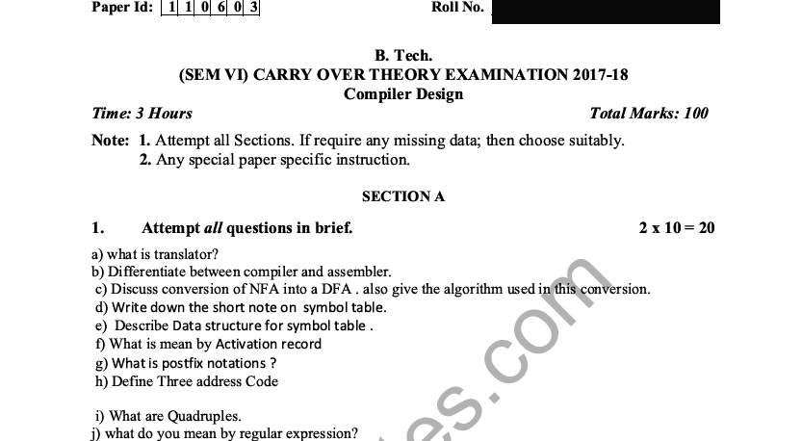
Old Question Papers

Slide 104
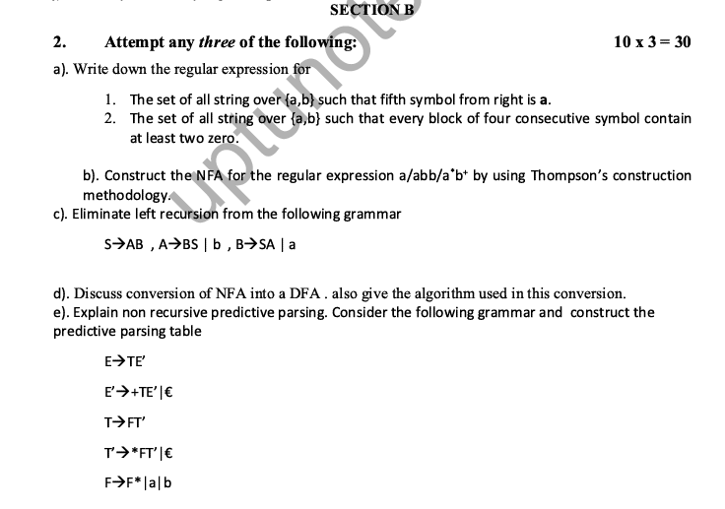
Old Question Papers

Slide 105
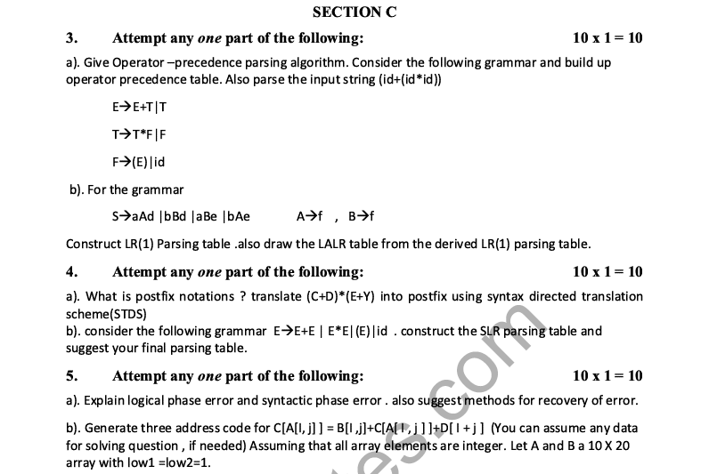
Old Question Papers

Slide 106
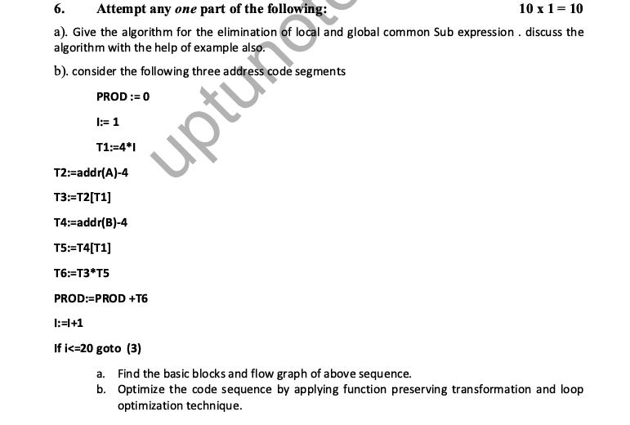
Old Question Papers

Slide 107
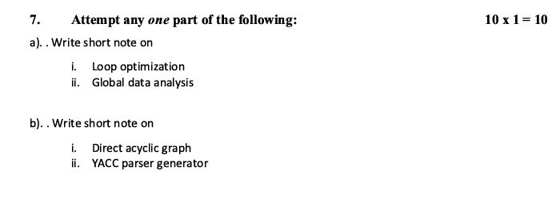
Old Question Papers

Slide 108
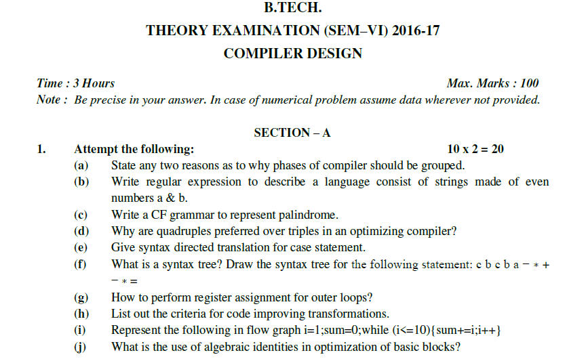
Old Question Papers

Slide 109
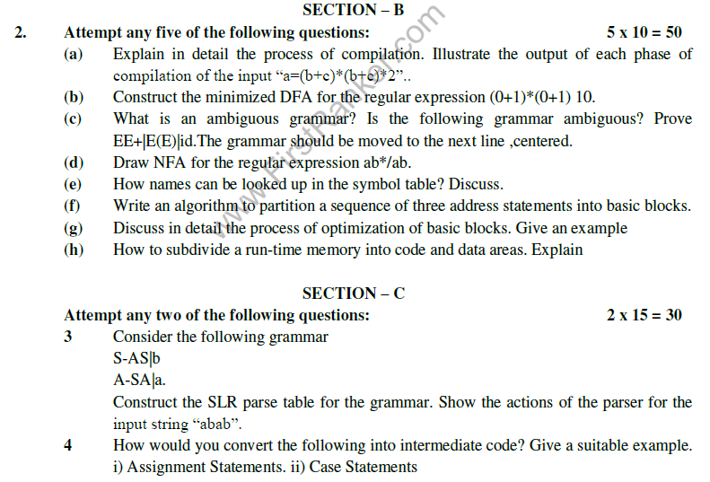
Old Question Papers

Slide 110
Old Question Papers

Slide 111
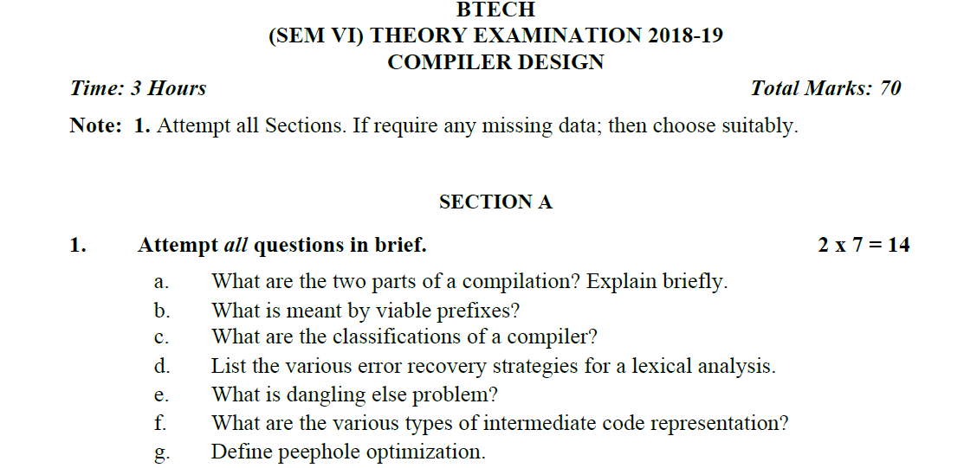
Old Question Papers

Slide 112
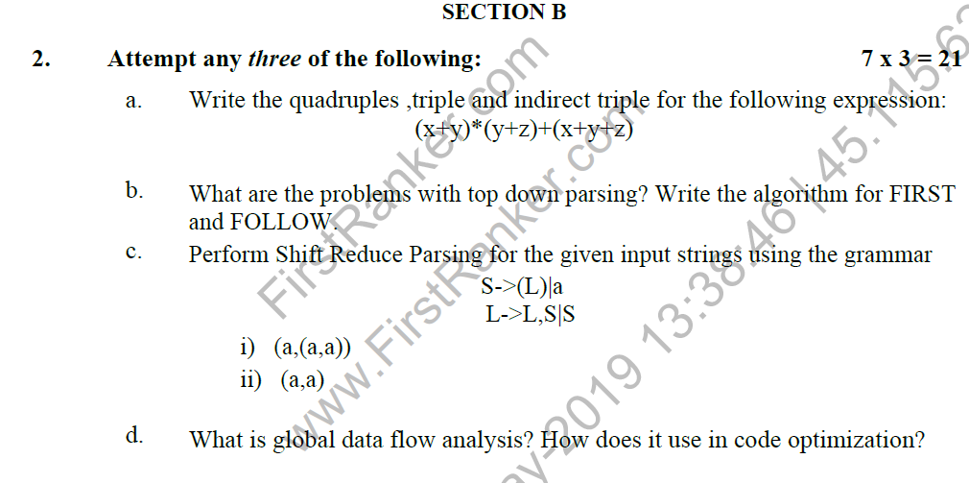
Old Question Papers

Slide 113
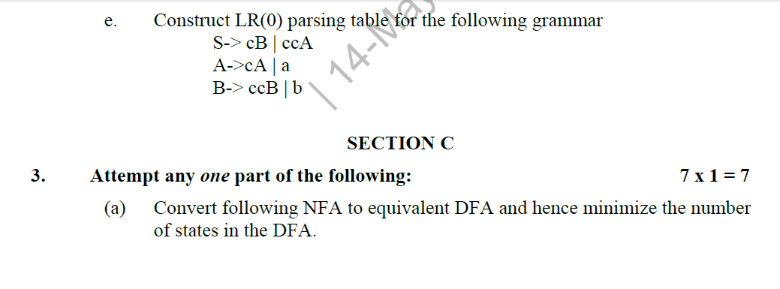
Old Question Papers

Slide 114
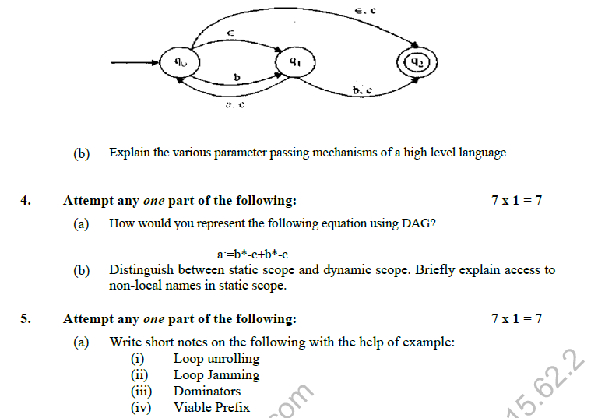
Old Question Papers

Slide 115
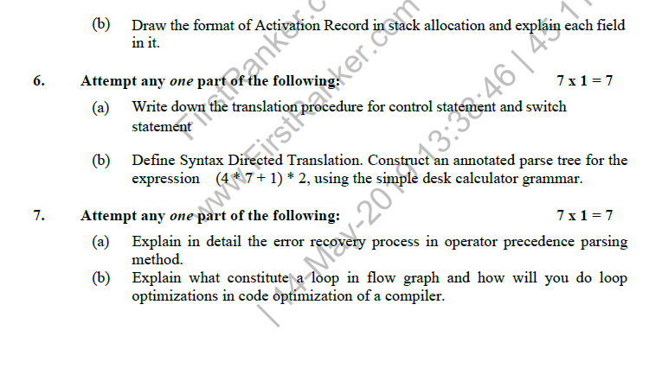
Old Question Papers

Slide 116
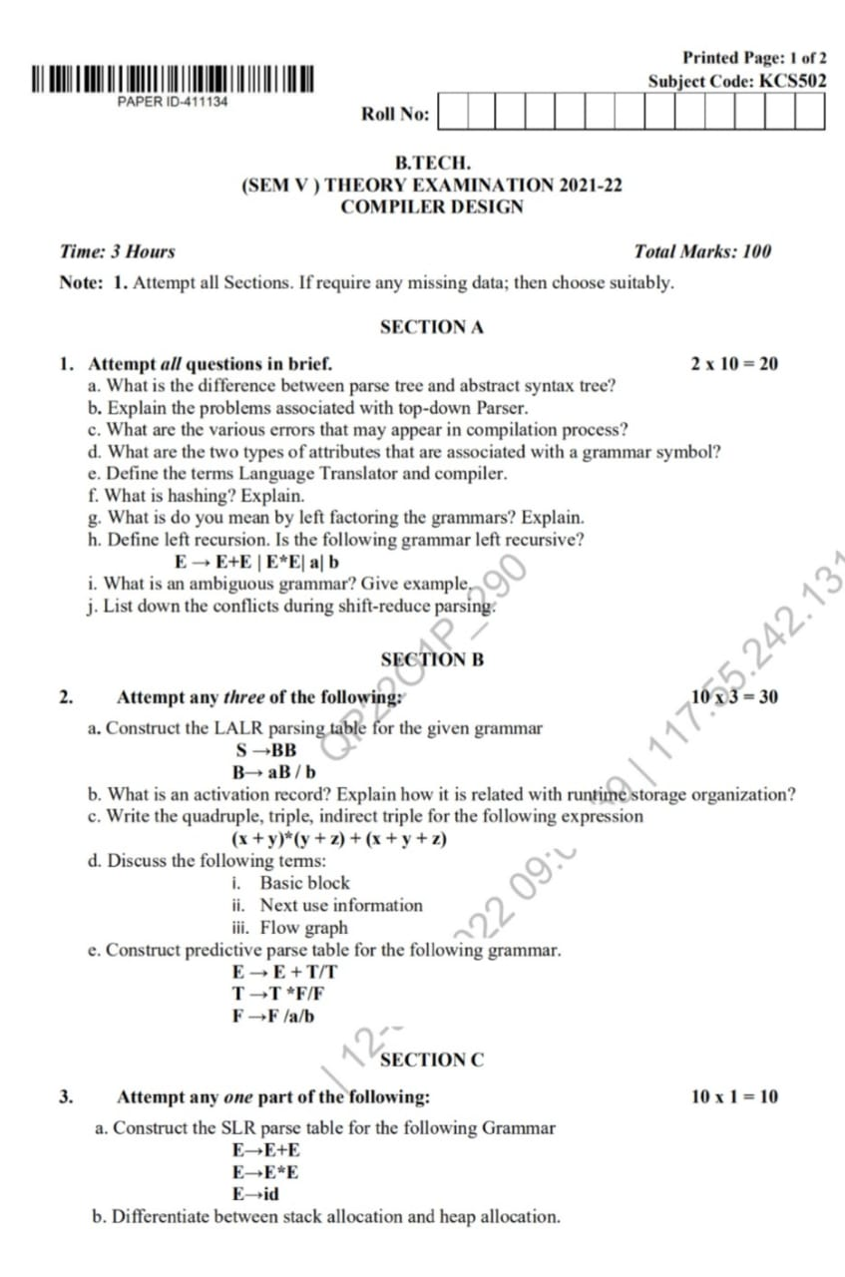
Old Question Papers

Slide 117
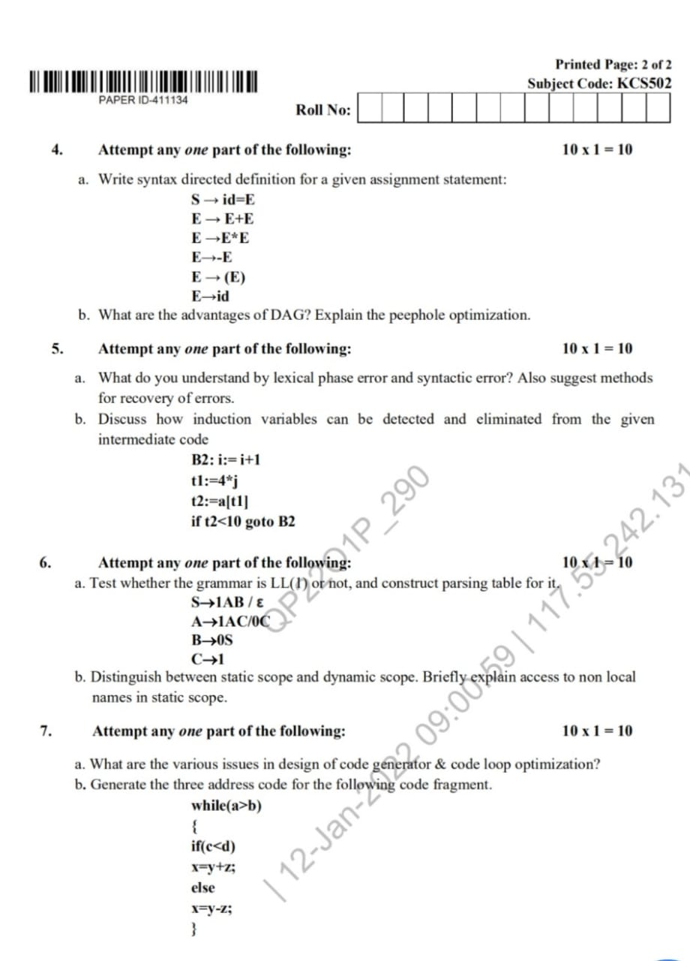
Old Question Papers

Slide 118
Expected Questions for University Exam
Create a new compiler for machine B which accepts a language L by using an existing compiler on machine A for language other than L.
Convert regular expression (a,b)*aba in a NFA by using Thomson rule and reduce it in equivalent DFA using ε-closure function.
Explain the implementation of lexical analyzer by taking the example of identifier.
What do you mean by translators? Discuss the structure of a compiler.
What is LEX compiler? Explain the working and advantage of LEX compiler.
Write short note on the following.
(i) Formal Grammar (ii) Left Recursion (iii) Left factoring

Slide 119
Recap of Unit
Lexical analysis turns input characters into tokens.
Lexical syntax is described by regular expressions.
Lexical analysis is the very first phase in the compiler designing
A lexeme is a sequence of characters that are included in the source program according to the matching pattern of a token
Lexical analyzer is implemented to scan the entire source code of the program
Lexical analyzer helps to identify token into the symbol table
A character sequence which is not possible to scan into any valid token is a lexical error
Removes one character from the remaining input is useful Error recovery method
Lexical Analyzer scan the input program.
It eases the process of lexical analysis and the syntax analysis by eliminating unwanted tokens

Slide 120
References
Principles of Compiler Design Textbook by Alfred Aho and Jeffrey Ullman
Principle of Compiler Design, A.V.Aho, Rabi Sethi, J.D.Ullman.
Compilers: Principles, Techniques and Tools A.V.Aho, Monica S. Lam, Rabi Sethi, J.D.Ullman
https://www.geeksforgeeks.org/compiler-design-tutorials/
https://www.javatpoint.com/compiler-tutorial
https://www.tutorialspoint.com/compiler_design/index.htm
https://nptel.ac.in/courses/106105190/

Slide 121
Noida Institute of Engineering and Technology, Greater Noida
Thank You

